Slide 1
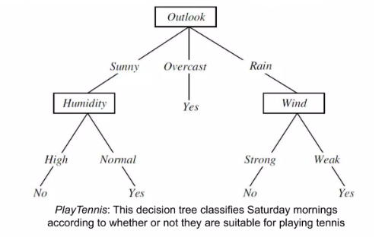
Decision Tree

Slide 2
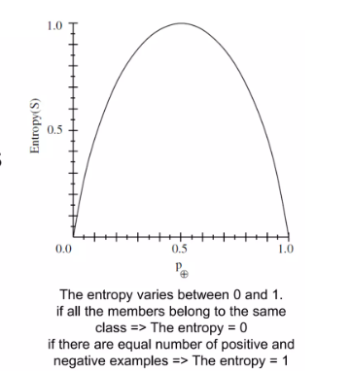
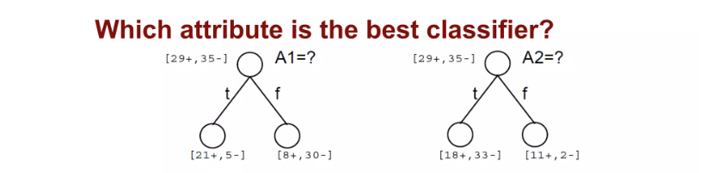
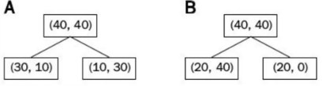
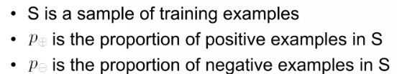
Entropy
Information Gain
= Entropy (before split) -Entropy( after split)

Slide 3
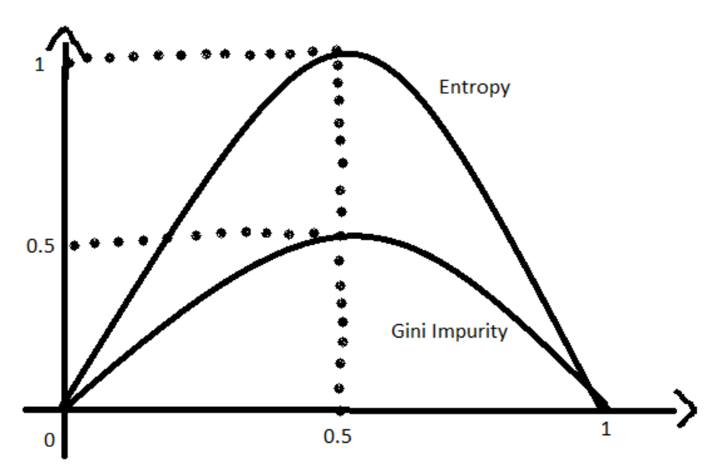
Gini Impurity
Better computation performance

Slide 4
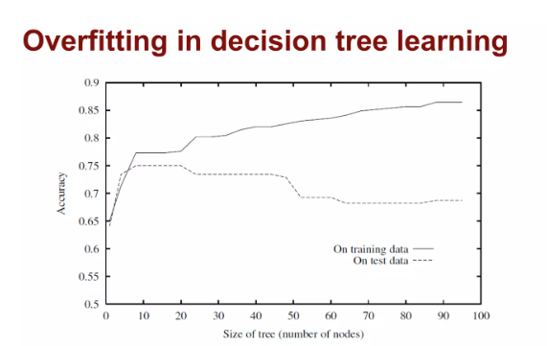
Overfitting

Slide 5
Overfitting
PRUNING
Insufficient/
noisy data
CAUSES | SOLUTIONS
SMALL # EXAMPLES
AT LEAF
ENSEMBLE LEARNING

Slide 6
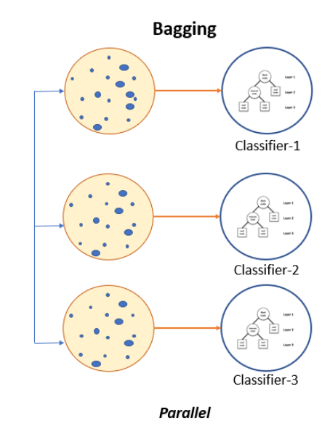
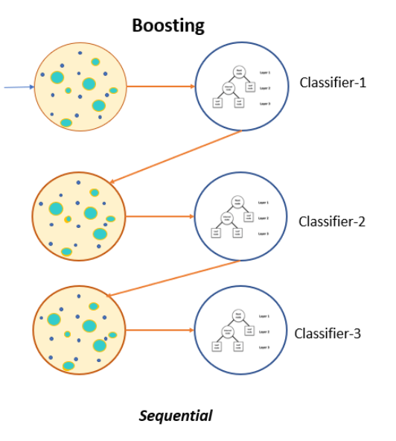
Ensemble Learning
BAGGING
BOOSTING

Slide 7
thank you

